Slide 1

2023
Team : Mitnick Minds
Team Leader : Abhyuday Patel
Problem ID : 1369
Theme : Smart Education
Institute : Indian Institute of Information
Technology , Ranchi

Slide 2

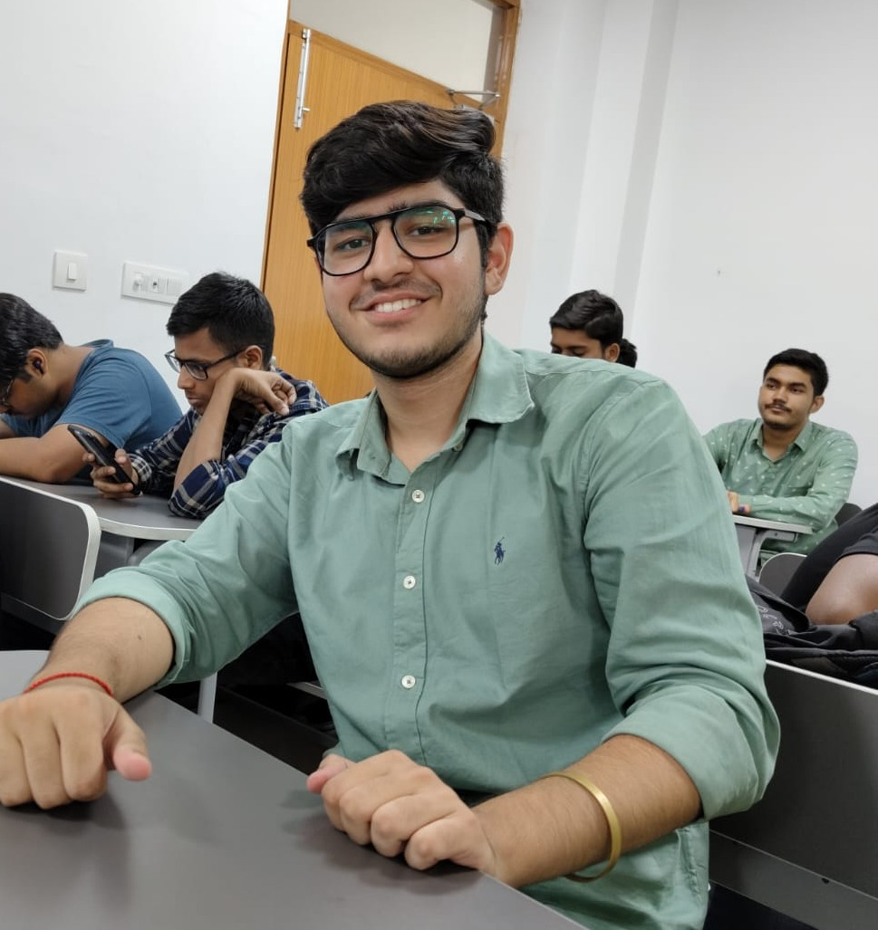
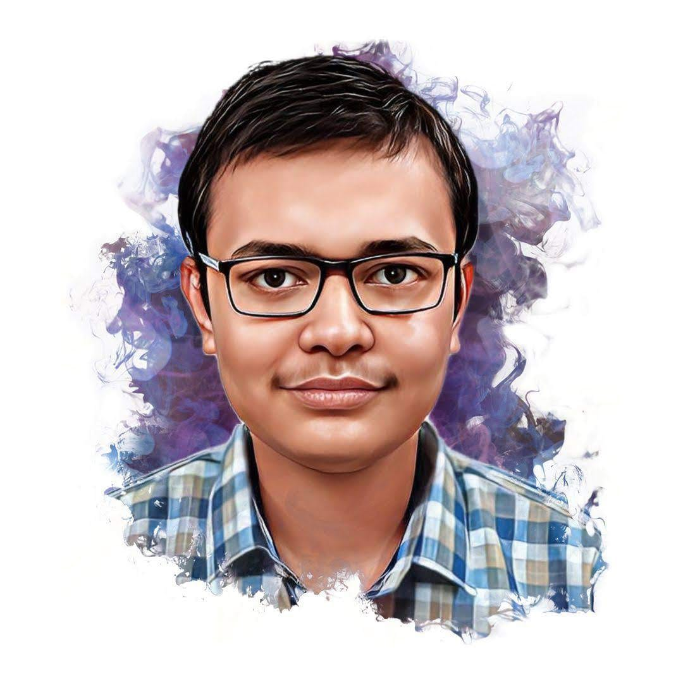

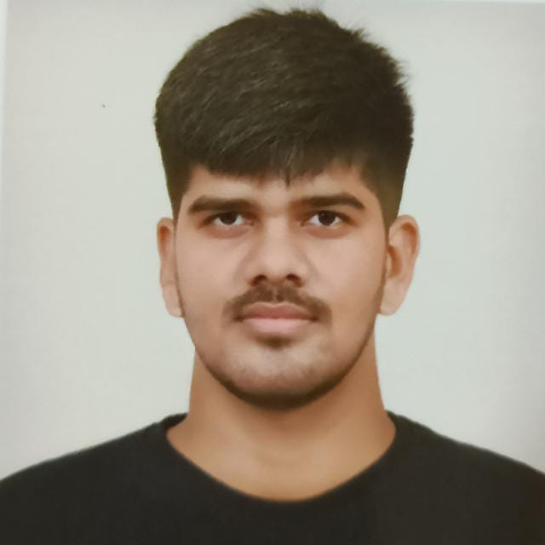
Our Team
SURAJ BHAN RANA Frontend
GOVIND MEHTA
Database
ABHYUDAY PATEL
Developer
Team Leader
PRATIK CHOURASIA
Presentation
RITURAJ SINGH
Presentation

Slide 3
Tech Stack
HTML
Tailwind Css
Bootstrap
Javascript
Django
SQLite
ChatGPT API
Plagarism Checker X

Slide 4
Problem Statement
To develop an online integrated
platform for projects taken up by the
students of various
universities/colleges.

Slide 5
Real Problem
About 56000 higher educational institutions in India .
Over 3 crores projects are made by students every year.
Many innovative projects created by students in various Institutions often remain hidden and inaccessible.
Unavailability of Trusted Project website .

Slide 6
Our Solution
National-Level Project Repository website.
Reducing duplication of efforts through Plagiarism Checker .
Project Summary.
Category filter for different category projects
Different sections for Code , PDF , images and download options .
Signup and Login for Institutes .

Slide 7
Use Cases
Resource can be tapped by industries, policymakers , and institutions for research and development purposes.
Helping in cross pollination of ideas among students and researchers.
Anyone can access these projects ,they can read and download the data from any part of world.
Helping in peer learning and research.
National level knowledge repository.

Slide 8
Thank You

